Slide 1

Introduction to
Adam Laczynski, Febury 2016

Slide 2
Agenda
Part 1
High level concepts
Build lifecycle
Gradle scripts syntax
Variables, properties
Tasks
Part 2
Plugins
Cli, Processes, Debugging, Daemon, Wrapper
Organizing build logic
Java plugin
Why Gradle
References

Slide 3
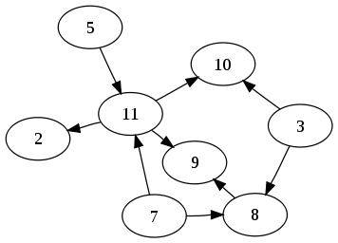
Building blocks
Project – component you’re trying to build or a goal you’re trying to achieve
contains many Tasks
has sub-projects
Task – group of actions
can depends on other Tasks
not inherited between related Projects
DAG (directed acyclic graph)
Settings – projects included in the build
contains many ProjectDescriptors
Notes:
Project
build: component’s jar
goal: deploy application
ProjectDescriptor – used to instantiate Project object

Slide 4
Gradle scripts
Gradle scripts are configuration scripts
As the script executes, it configures an object of a particular type
Gradle script implements the Script interface
Provides helper method like file(<path>), exec(<command>), …

Slide 5
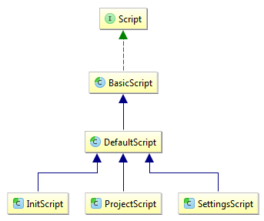
Script types
(Project) Build script
build.gradle delegates to Project instance
Settings script
settings.gradle delegates to Settings instance
Init script
USER_HOME/.gradle/init.gradle delegates to Gradle instance
Notes:
https://docs.gradle.org/current/dsl/
- USER_HOME/.gradle/init.gradle – one of possible option, https://docs.gradle.org/current/userguide/init_scripts.html

Slide 6
Ex1
Concepts

Slide 7
Build lifecycle
Initialization phase
Create Settings instance and evaluate settings.gradle script, if present
Create hierarchy of Project instances for Settings
Configuration phase
Evaluate the build.gradle of each relevant Project
--configure-on-demand
Execution phase
Execute tasks actions
Notes:
https://docs.gradle.org/current/dsl/org.gradle.api.Project.html
--configure-on-demand Only relevant projects are configured in this build run. This means faster build for large multi-project builds. [incubating]. In the long term, this mode will become the default mode

Slide 8
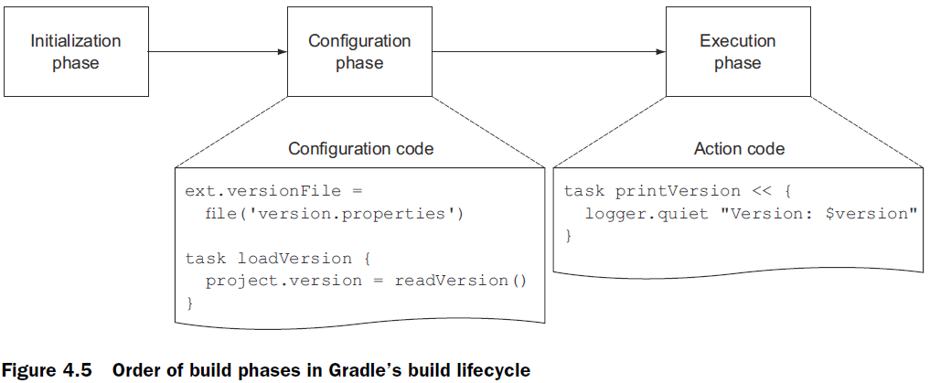
Build lifecycle

Slide 9
Ex2
Groovy/Gradle scripts syntax
Notes:
https://docs.gradle.org/current/userguide/writing_build_scripts.html (13.7. Some Groovy basics)
http://www.groovy-lang.org/semantics.html

Slide 10
Variables
Local variables
Not visible in sub-projects
Groovy script variables – traps https://docs.gradle.org/current/userguide/potential_traps.html
Ex3

Slide 11
Build properties
Some properties
org.gradle.daemon=true
org.gradle.debug=true
org.gradle.jvmargs=…
How to set
gradle.properties in project dir
gradle.properties in $GRADLE_USER_HOME or in $USER_HOME/.gradle
Command line, -Dorg.gradle.debug=true
GRADLE_OPTS or JAVA_OPTS
Ex4
Notes:
https://docs.gradle.org/current/userguide/build_environment.html#properties
The properties file in the user's home directory has precedence over property files in the project directories.

Slide 12
Project properties
Access like to script variable
If does not exist exception is thrown
hasProperty(<name>) method to check existence
Visible in sub-projects
Use this feature to define e.g. versions in root project

Slide 13
Project properties
How to set
gradle.properties in project (sub-project) dir
gradle.properties in $GRADLE_USER_HOME or in $USER_HOME/.gradle
Command line
-P<key>=<value>
-Dorg.gradle.project.<key>=<value>
Environment variable ORG_GRADLE_PROJECT_<key>=<value>
Extra properties (supported also for Task)
Ex4

Slide 14
System properties
Could be set in gradle.properties file via systemProp.<key>=<value>

Slide 15
Task – essentials
Has a name
Made up of a sequence of Actions
Can depends on other Tasks
Registered as project property
Not inherited between projects
Executed only once (gradle clean clean)

Slide 16
Task – essentials
Creation
Project creates Task
Task belongs only to one Project instance
Various methods to create Task
Supports ext properties
Project.defaultTasks
Ex5

Slide 17
Task – a bit more
Custom task – Ex6
Skipping tasks
Using predicate onlyIf
Throw StopExecutionException
Enabling and disabling tasks <task>.enabled = false
Skipping tasks that are up-to-date – Ex7
Define TaskInputs/TaskOutputs
TaskOutputs.upToDateWhen() for not file oriented outputs
Incremental task – incubating feature
@TaskAction void execute(IncrementalTaskInputs inputs) {}
Notes:
https://docs.gradle.org/current/userguide/custom_tasks.html

Slide 18
Task – a bit more
Task rules and options – Ex8
task whose behavior depends on a large or infinite number value range of parameters
Finalizer tasks
taskX.finalizedBy taskY
Finalizer tasks will be executed even if the finalized task fails

Slide 19
Plugin
Extends project's capabilities
Creates new Tasks
Configures Project
Adds new DSL to the Project
Types
Script: apply from: ‘other.gradle’
Binary: apply plugin: ‘java’
Core and Custom plugins
https://docs.gradle.org/current/userguide/standard_plugins.html - core/standard plugins
https://plugins.gradle.org/ - custom plugin portal

Slide 20
Applying a binary plugin
apply by id
apply plugin: ‘java’
apply by type (class name)
apply plugin: JavaPlugin
or via new DSL
plugins {
id ‘java’
}
Notes:
apply by id (core plugins uses short name, community plugins should use fully qualified name)

Slide 21
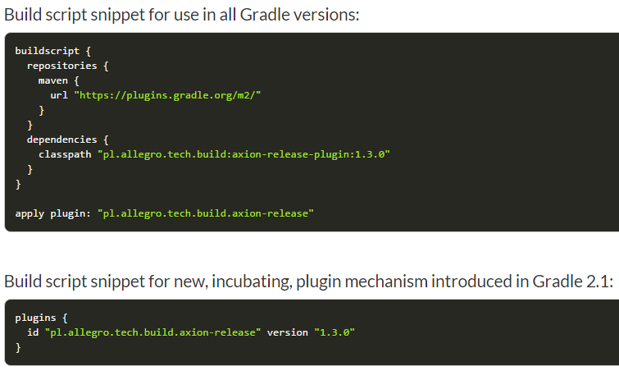
Plugin – new DSL

Slide 22
Custom plugin
Where to put plugin source code
build script
buildSrc project
rootProjectDir/buildSrc/src/main/groovy
standalone project
Which plugins were applied?
./gradle properties (property key: plugins)
Ex9

Slide 23
Custom plugin - testing
ProjectBuilder
Low level testing of plugin configuration
No build execution
TestKit
Functional testing (build execution)
Nebula-test (deprecated)
Replaced by TestKit
Ex9-5
Notes:
ProjectBuilder
https://docs.gradle.org/current/userguide/custom_plugins.html#sec:writing_tests_for_your_plugin
https://discuss.gradle.org/t/how-to-execute-a-task-in-unit-test-for-custom-plugin/6771
TestKit
https://docs.gradle.org/current/userguide/test_kit.html
https://github.com/gradle/gradle/blob/master/design-docs/testing-toolkit.md
Nebula
https://github.com/nebula-plugins/nebula-test
https://nebula-plugins.github.io/documentation/plugin_overview.html

Slide 24
Cli
gradle [option...] [task...]
gradle -h
gradle help
gradle tasks --all
gradle help --task <name>
gradle projects
gradle properties
gradle --info --debug --stacktrace
gradle --profile
gradle task1 task1
task1 will be executed once
gradle mT = gradle myTask
task name abbreviation
gradle dist -x test
gradle --continuous
gradle --continue
gradle --gui
Notes:
Cli example based on Ex10
https://docs.gradle.org/current/userguide/tutorial_gradle_command_line.html
gradle --profile
- generates execution report

Slide 25
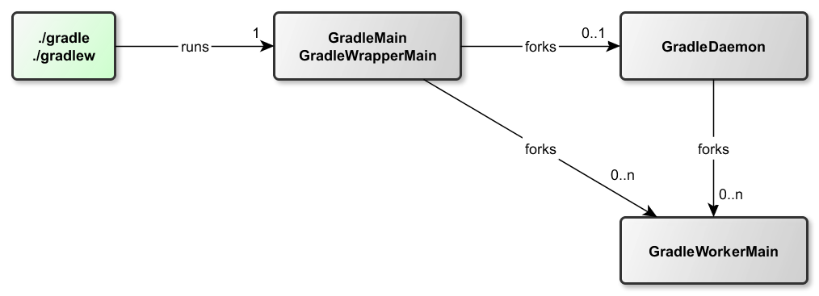
Java processes
GradleMain or GradleWrapperMain
./gradle, ./gradlew – always 1 new jvm created
When org.gradle.jvmargs is specified then 2nd jvm is created (GradleDaemon)
GradleDaemon
GradleWorkerMain
Each execution of test task creates new worker
--parallel option
max-workers = number of processors by default

Slide 26
Debugging gradle script
Run build script as debug in IDE
Remote debug
./gradle -Dorg.gradle.debug=true
also supported via gradle.properties, GRADLE_OPTS
or -Dorg.gradle.jvmargs=…
Notes:
1. IDE dubug
Ex10, JavaPlugin breakpoint, run build.gradle

Slide 27
Debugging forked jvm GradleWorkerMain
Only remote debuging
-agentlib:jdwp=transport=dt_socket,server=y,suspend=y,address=5005
Can be specified only in task configuration
tasks.withType(JavaForkOptions) { systemProperty "cool.opt", "1“ jvmArgs “args“ }
tasks.withType(JavaCompile) { options.fork = true // otherwise won't fork options.forkOptions.jvmArgs = [“args”] }
Test task (gradle help --task test)
shortcut: gradle someTestTask --debug-jvm

Slide 28
Daemon
Use it always on local dev machine
Activation
org.gradle.daemon=true in gradle.properties
gradle --daemon
gradle --no-daemon
Daemon can be debugged

Slide 29
Wrapper
Script which download (if needed) and start gradle
task wrapper(type: Wrapper) { gradleVersion = '2.9’ }
Result of Wrapper task execution should be committed to repository (few small files)
Accessing from sub-projects
https://issues.gradle.org/browse/GRADLE-2429
http://www.gdub.rocks/

Slide 30
Organizing build logic
Custom tasks/plugins
Multi-project build
Inherited properties and methods
Injected configuration
subprojects {}, allprojects {}, project(name).task << {}
buildSrc project
build.gradle is optional, by default groovy plugin applied
Ex - https://github.com/mockito/mockito
Shared scripts
apply from: 'other.gradle‘
Execute external build
task build(type: GradleBuild) { buildFile = 'other.gradle' tasks = ['hello'] }

Slide 31
Java plugin
Source sets – group of source files (main, test)
Tasks
Dependencies
Bunch of project properties (e.g. sourceCompatibility, distsDir, ...)

Slide 32
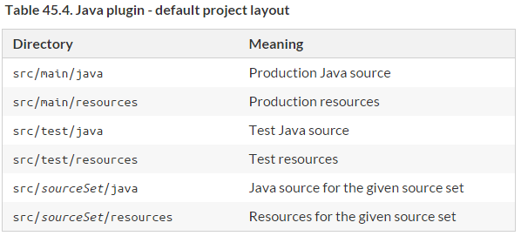
Java plugin – source sets

Slide 33
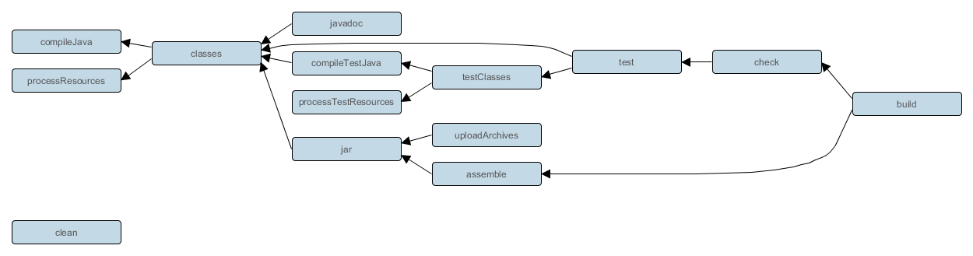
Java plugin - tasks

Slide 34
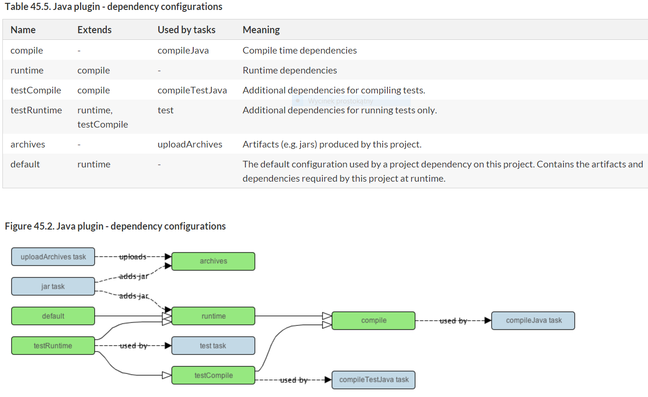
Java plugin - dependencies

Slide 35
Ex11
Java plugin

Slide 36
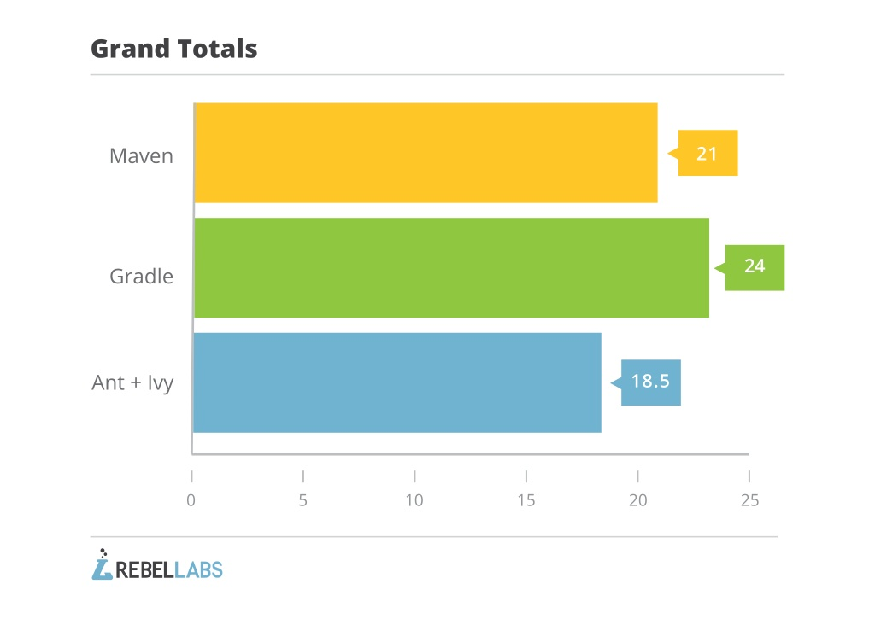
Why Gradle?
http://zeroturnaround.com/rebellabs/java-build-tools-part-2-a-decision-makers-comparison-of-maven-gradle-and-ant-ivy/ - August 21, 2014
Notes:
http://technologyconversations.com/2014/06/18/build-tools/
http://zeroturnaround.com/rebellabs/java-build-tools-part-2-a-decision-makers-comparison-of-maven-gradle-and-ant-ivy/

Slide 37
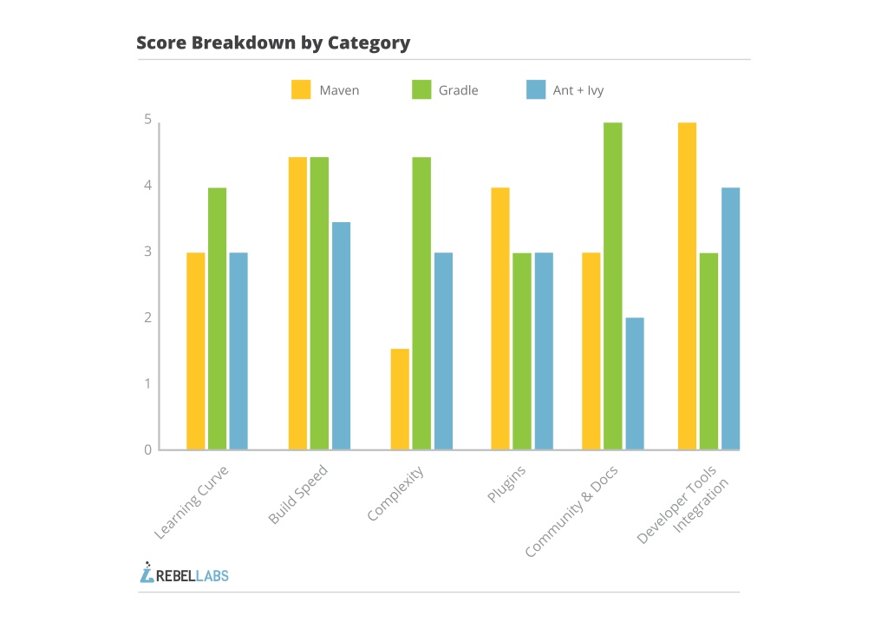

Slide 38
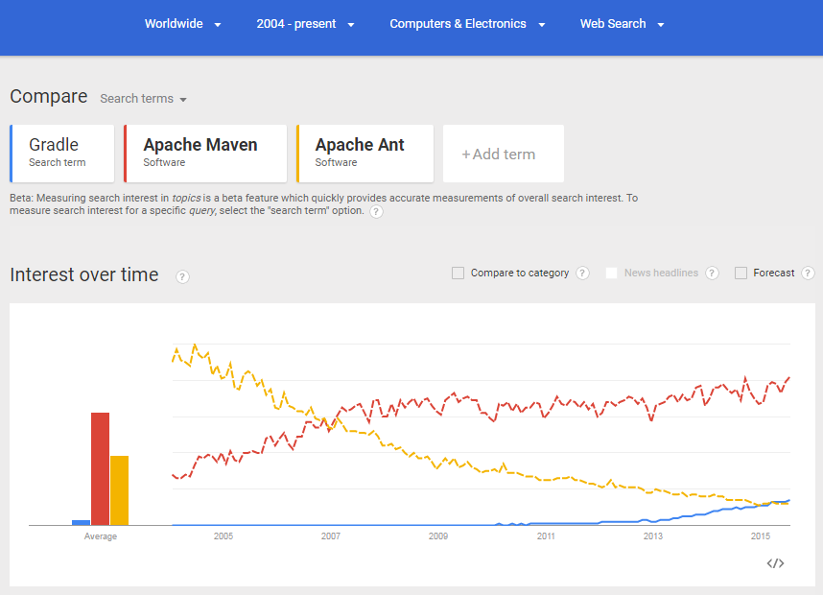

Slide 39
References
https://docs.gradle.org/
User Guide, DSL Reference
https://plugins.gradle.org/
https://github.com/gradle/gradle/tree/master/subprojects/docs/src/samples
Gradle in Action (February 2014, 480 pages) - http://manning.com/muschko/
Rocking the Gradle with Hans Dockter –youtube
Explore existing projects/plugins (e.g. spring-framework, mockito, https://github.com/nebula-plugins - netflix, ...)

Slide 40


